Slide 1
Innovation Cluster
North Metropolitan TAFE – Joondalup
Semester 1 - 2023
Course
Certificate IV in Information Technology | Web
Certificate IV in Information Technology | Programming
Certificate IV in Information Technology | Networking

Slide 2
Innovation Cluster/Project
Digital Collaboration: Tools and Processes
Brad Higgins, Lecturer NMTAFE
Session 03
Unit of Competency | Code
Identify and evaluate emerging technologies and practices | ICTICT426
Work collaboratively in the ICT industry | ICTICT443
Apply advanced critical thinking to work processes | BSBCRT404

Slide 3
Overview
Legal and regulatory requirements that inform policy governing use of collaborative tools
  Laws
  Regulations
  Codes and Standards
  Policy
Best Practice when using Collaborative Software
Innovative Technology Presentations and Reflection

Slide 4

Laws and regulations
Collaborative Software

Slide 5
Collaborative Tools
Collaborative tools have become increasingly popular for communication, collaboration, and information sharing. However, their use is governed by a variety of laws and regulations, including data privacy, intellectual property, and accessibility laws. In this lesson, we will explore the key legal and regulatory requirements specific to Australia that inform policies for the use of collaborative tools.

Slide 6
Data Privacy Laws
In Australia, data privacy is governed by the Privacy Act 1988. The Privacy Act requires organizations to comply with privacy principles, including collection, storage, use, and disclosure of personal information.
In the context of collaborative tools, this means that policies must be in place to ensure that sensitive personal information is not shared inappropriately and that appropriate measures are taken to secure data.

Slide 7
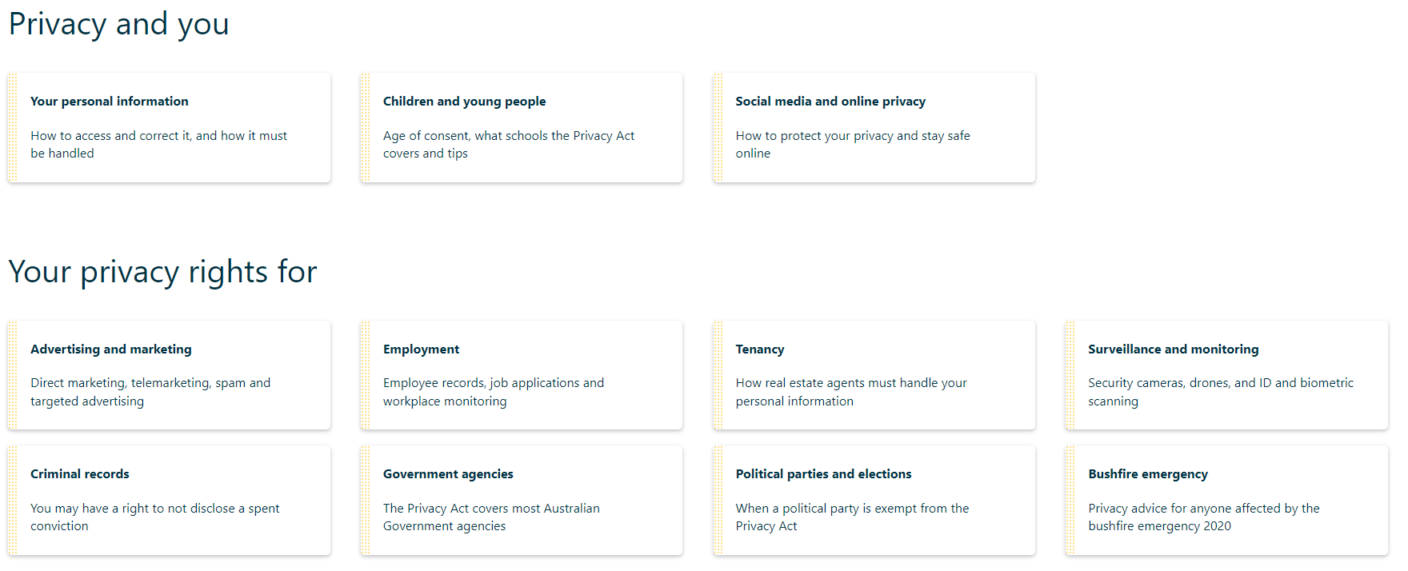
Data Privacy Laws
https://www.ag.gov.au/rights-and-protections/privacy
https://www.oaic.gov.au/

Slide 8
Data Privacy Laws
How do these privacy laws impact the way we use collaborative software?
Scenario: How could the Privacy Act 1988 apply to a large multinational company operating in Australia?

Slide 9
Data Privacy Laws
A large multinational corporation that uses a collaborative software platform for communication and information sharing between its employees and partners across the globe. The software platform allows users to store and share sensitive personal information, such as client data, financial information, and confidential business information.
Under the Privacy Act 1988, the corporation is required to comply with privacy principles, including the collection, storage, use, and disclosure of personal information. In this scenario, the corporation must ensure that appropriate measures are in place to secure the sensitive personal information stored and shared through the collaborative software platform. This could include implementing encryption technologies, restricting access to sensitive data, and regularly monitoring the platform for any unauthorized access or breaches.
Additionally, the corporation must have policies in place to ensure that personal information is not disclosed inappropriately. For example, employees must be trained on the proper use of the collaborative software platform and must be informed of the consequences of sharing personal information without consent. The corporation must also have processes in place for dealing with privacy breaches, such as reporting incidents to the relevant authorities and taking steps to prevent similar breaches from occurring in the future.
In this scenario, the Privacy Act 1988 applies to the use of the collaborative software platform and informs the corporation's policies and practices for ensuring the privacy of sensitive personal information stored and shared through the platform.

Slide 10
Intellectual Property Laws
Intellectual property laws in Australia are governed by the Copyright Act 1968 and the Trademarks Act 1995. In the context of collaborative tools, it is important to understand and comply with copyright laws, as well as licensing agreements that may be in place.
For example, policies should specify who owns the intellectual property created using collaborative tools and how it may be used and shared.

Slide 11
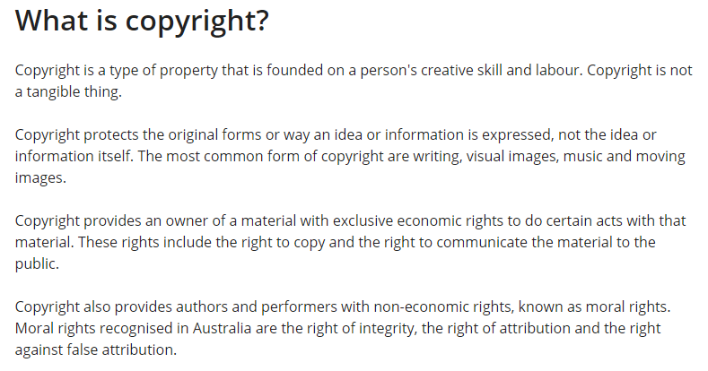
Intellectual Property Laws
https://www.infrastructure.gov.au/media-communications-arts/copyright/copyright-basics
https://www.ag.gov.au/rights-and-protections/copyright/copyright-basics

Slide 12
Intellectual Property Laws
How do these IP laws impact collaborative Software usage in Australia?
How might these laws apply to a small startup company?

Slide 13
Intellectual Property Laws
A small startup company that develops a new software platform for collaboration and project management. The platform allows teams to store, share, and collaborate on files, such as documents, presentations, and spreadsheets.
Under intellectual property laws in Australia, the startup company must ensure that it complies with copyright laws and licensing agreements. For example, the company must have policies in place to specify who owns the intellectual property created using the software platform, such as the original authors of the documents or presentations, and how the intellectual property may be used and shared.
Additionally, the company must ensure that it is not using any third-party intellectual property without proper authorization. For example, if employees use the software platform to store and share music or videos, the company must ensure that it has obtained the necessary licenses or permissions to do so.
In this scenario, intellectual property laws apply to the use of the collaborative software platform and inform the company's policies and practices for ensuring the proper use and protection of intellectual property stored and shared through the platform.

Slide 14
Accessibility Laws
Accessibility laws in Australia are governed by the Disability Discrimination Act 1992. The act requires that goods, services, and facilities be provided in a non-discriminatory manner and be accessible to individuals with disabilities.
In the context of collaborative tools, this means that policies must be in place to ensure that the tools are accessible to individuals with disabilities, such as by including closed captioning for videos or alt text for images.

Slide 15

Accessibility Laws
https://humanrights.gov.au/our-work/employers/disability-discrimination

Slide 16
Accessibility Laws
How would the laws around accessibility impact the usage of collaborative software?
A government agency provides a communication platform for its employees / customers. What are some ways this software could accommodate the requirements under the discrimination act?

Slide 17
Accessibility Laws
A government agency that uses a collaborative software platform for communication and information sharing between its employees, contractors, and members of the public. The software platform includes features such as document sharing, video conferencing, and online forums.
Under the Disability Discrimination Act, the government agency must ensure that its services, including the use of the collaborative software platform, are accessible to people with disabilities. This includes individuals who are blind or have visual impairments, deaf or hard of hearing, or mobility impairments, among others.
To comply with the DDA, the government agency must ensure that the software platform is designed with accessibility in mind, such as providing text-to-speech options for visually impaired users, closed captioning for deaf or hard of hearing users, and keyboard-only navigation for users with mobility impairments. The agency must also provide training and support to employees and contractors on how to use the platform in an accessible manner.
In this scenario, the DDA impacts the use of the collaborative software platform by informing the government agency's policies and practices for ensuring that its services, including the software platform, are accessible to people with disabilities.

Slide 18
Cybersecurity Laws
Cybersecurity laws in Australia are governed by the Cyber Security Strategy 2015. The strategy aims to enhance the security of the Australian government's information and communications technology systems.
In the context of collaborative tools, this means that policies must be in place to ensure the security of data stored and shared using the tools.

Slide 19
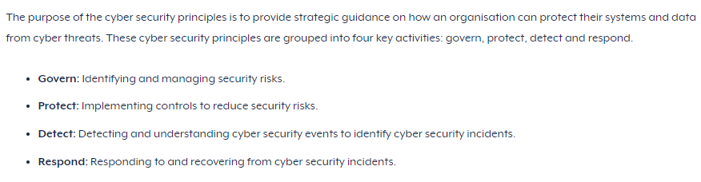
Cybersecurity Laws
https://www.cyber.gov.au/
https://www.cyber.gov.au/acsc/view-all-content/advice/using-information-security-manual

Slide 20
Cybersecurity Laws
How does cybersecurity law impact the use of collaborative software?
How might the cyber security laws impact a financial institution and the way they store data?

Slide 21
Cybersecurity Laws
A financial institution that uses a collaborative software platform for communication and information sharing between its employees and partners. The software platform allows users to store and share sensitive financial information, such as client data, financial transactions, and confidential business information.
Under cyber security laws in Australia, the financial institution must ensure that appropriate measures are in place to protect the sensitive information stored and shared through the collaborative software platform. This includes complying with the mandatory data breach notification requirements under the Privacy Act 1988 and the Cybersecurity Information Sharing Act 2015.
Additionally, the financial institution must implement robust cybersecurity measures to protect against cyber threats, such as malware attacks, phishing scams, and unauthorized access to sensitive information. This could include implementing firewalls, encryption technologies, and regular security updates for the software platform. The institution must also have policies in place for employees to follow when using the platform, such as avoiding the use of personal devices for work purposes and not sharing login credentials.
In this scenario, the cyber security laws of Australia affect the usage of the collaborative software platform by informing the financial institution's policies and practices for ensuring the security and protection of sensitive financial information stored and shared through the platform.

Slide 22
Company Policies
Collaborative Software

Slide 23
Company Policies Governing Collaborative Software
Some example policies include:
Acceptable Use Policy
Data Protection Policy
Intellectual Property
Accessibility Policy
Cybersecurity Policy

Slide 24
Company Policies Governing Collaborative Software
1. Acceptable Use Policy: This policy outlines the acceptable behaviors and actions for employees when using the collaborative software platform. It could include rules on using the platform for work purposes only, avoiding the use of personal devices, and not sharing login credentials.
2. Data Protection Policy: This policy outlines the company's approach to protecting sensitive information stored and shared through the collaborative software platform. It could include requirements for encryption technologies, restricting access to sensitive data, and regularly monitoring the platform for any unauthorized access or breaches.

Slide 25
Company Policies Governing Collaborative Software
3. Intellectual Property Policy: This policy outlines the company's approach to protecting and managing intellectual property created using the collaborative software platform. It could include rules on who owns the intellectual property and how it may be used and shared.
4. Accessibility Policy: This policy outlines the company's approach to ensuring that the collaborative software platform is accessible to people with disabilities. It could include requirements for accessibility features, such as text-to-speech options, closed captioning, and keyboard-only navigation.

Slide 26
Company Policies Governing Collaborative Software
5. Cybersecurity Policy: This policy outlines the company's approach to protecting against cyber threats, such as malware attacks, phishing scams, and unauthorized access to sensitive information. It could include requirements for firewalls, encryption technologies, and regular security updates.

Slide 27
Company Policies Governing Collaborative Software
As a group, find two examples of each policy listed (one government, one private) and locate the sections which apply to the use of collaborative software. Provide the URL and a screenshot of the relevant section. Submit to BB.
Acceptable Use Policy
Data Protection Policy
Intellectual Property
Accessibility Policy
Cybersecurity Policy

Slide 28
Best Practice and protocols
Collaborative Software

Slide 29
Developing Protocols for Collaborative Software
Some examples of protocols used to effectively utilise collaborative software include:
  Scheduled regular meetings
  Shared documents
  Task management systems
  Establish communication channels
  File sharing
  Time management
  Reflection and review

Slide 30
Developing Protocols for Collaborative Software
1. Scheduled Regular Meetings: Scheduling regular virtual meetings, such as video conferences or audio calls, can help keep team members connected and on track. These meetings can be used for status updates, problem-solving, and team-building.
2. Shared Documents: Utilizing shared document platforms, such as Google Docs or Microsoft Teams, can allow team members to collaborate in real-time on documents and projects. These platforms also provide a centralized location for storing and organizing documents.

Slide 31
Developing Protocols for Collaborative Software
3. Task Management Systems: Utilizing task management systems, such as Trello or Asana, can help keep track of individual and team tasks, deadlines, and progress. These systems can also help facilitate communication and collaboration among team members.
4. Communication Channels: Establishing clear communication channels, such as instant messaging or email, can help ensure that team members are able to quickly and easily communicate with one another.

Slide 32
Developing Protocols for Collaborative Software
5. File Sharing: Utilizing file sharing platforms, such as Dropbox or Google Drive, can allow team members to easily access and share files with one another.
6. Time Management: Establishing time management protocols, such as setting specific work hours or using time tracking software, can help ensure that team members are able to effectively balance work and personal time.
Reflection and Review: To be seen after the presentations

Slide 33
Developing Protocols for Collaborative Software
From the list below, choose 3 criteria to build your team’s collaboration protocol around:
Scheduled regular meetings
Shared documents
Task management systems
Establish communication channels
File sharing
Time management
Reflection and review

Slide 34
Presentations
Innovative Technology

Slide 35
Reflection and review
Innovative Technology

Slide 36
Reflection – Why is it important?
Improves presentation skills: Reflecting on a group presentation allows students to analyze their performance and identify areas where they need improvement. This can help them develop their presentation skills and become more confident in public speaking.
Encourages teamwork and collaboration: Group presentations require students to work together, and reflecting on the process can help students understand the strengths and weaknesses of their team and identify ways to improve their collaboration in the future.
Builds self-awareness: Reflecting on a presentation helps students become more self-aware and recognize their own strengths and weaknesses. This self-awareness is important for personal growth and future success.
Enhances learning: Reflecting on a presentation allows students to process and retain the information presented in a deeper way, as well as identify areas where they need additional learning or clarification.
Develops critical thinking skills: Reflecting on a presentation requires students to analyze and evaluate their own performance and the performance of their team. This develops critical thinking skills that can be applied to other areas of their education and future careers.

Slide 37
Reflection and Review
Introduction:
  Date of presentation:
  Group members:
  Topic of presentation:
Strengths of the Presentation:
  What did the group do well during the presentation?
  What aspects of the presentation stood out to you?
Areas for Improvement:
  What could the group have done better during the presentation?
  What areas of the presentation need improvement?
Personal Contributions:
  What role did you play in the presentation?
  What did you contribute to the presentation?
  How well did you fulfill your role in the presentation?
Collaboration:
  How well did the group work together during the presentation?
  Was there good communication and teamwork among group members?
Final Thoughts:
  What did you learn from the presentation experience?
  How will you apply what you learned in future presentations?

